Slide 1
CHAPTER 3
Data Modeling Using the Entity-Relationship (ER) Model

Slide 2
Overview of Database Design Process
Two main activities:
Database design
Applications design
Focus in this chapter on conceptual database design
To design the conceptual schema for a database application
Applications design focuses on the programs and interfaces that access the database
Generally considered part of software engineering

Slide 3
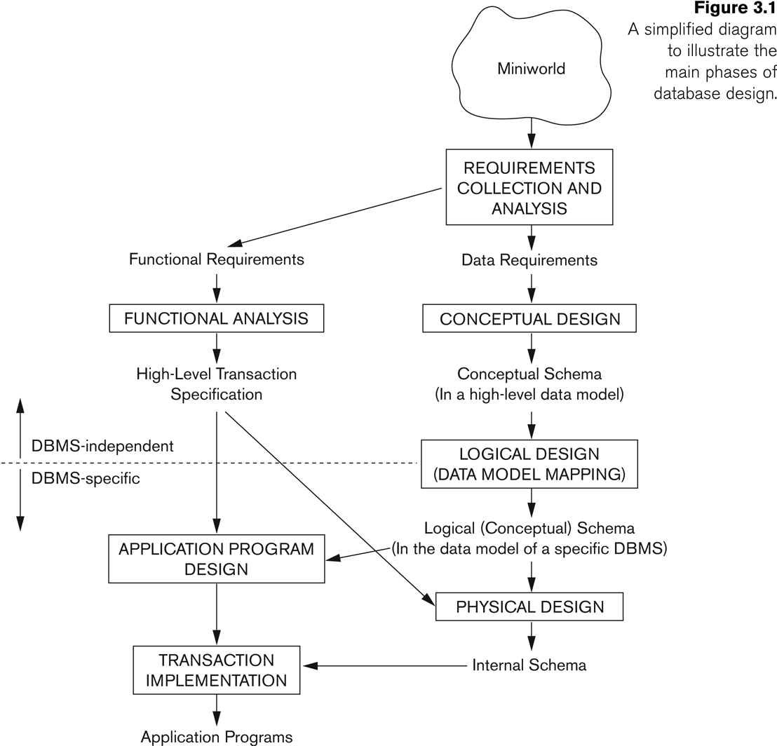
Overview of Database Design Process

Slide 4
Lecture Outline for ERM/ERD
Terminologies in relation to the ER Model:
a. Entity.
b. Attributes:
• Composite vs Simple Attributes
• Single-valued vs Multivalued Attributes
• Derived vs Stored Attributes
c. Complex Attributes.
d. Null values.
e. Entity Type, Entity Set.
f. Key Attribute & Value Set of Attributes.

Slide 5
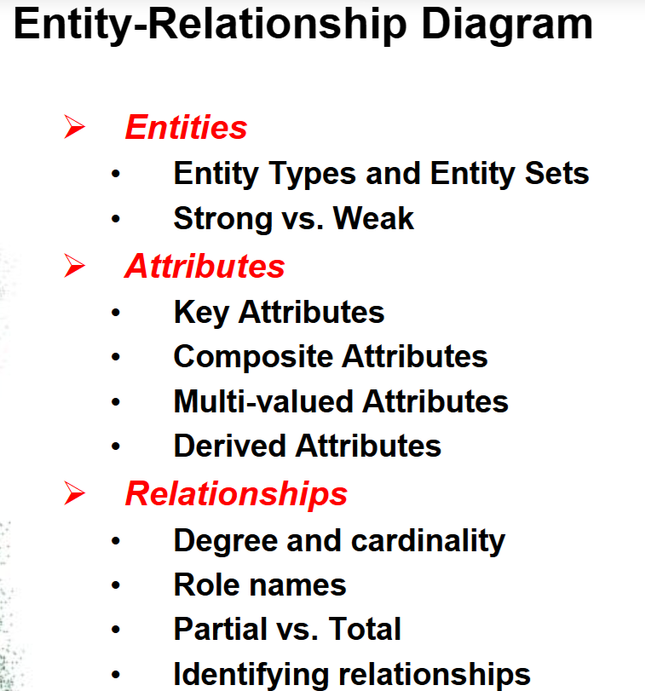

Slide 6
ERM/ERD
Entity:
An entity is a “thing" in the real world with an independent existence. May be an object with physical existence (ex: house, person) or
with a conceptual existence(ex: course, job)
Attributes:
Properties that describe the entities.
Person(E):
NAME
AGE
ADDRESS
PHONENUMBER

Slide 7
ERM/ERD
Entity Type:
A collection of entities thathave the same attributes.
Ex: STUDENT
Entity Set:
Collection of entities of a particular entity type at a point in time.
Key Attribute:
That attribute that iscapable of identifying eachentity uniquely.
Ex: Roll number of a student

Slide 8
ERM/ERD
Weak Entity:
Entity types that do not have key attributes of their own.
WEs are identified by relating to another entity type called the identifying or the owner entity type.
Relationship between weak entity type to its owner -> identifying relationship.

Slide 9
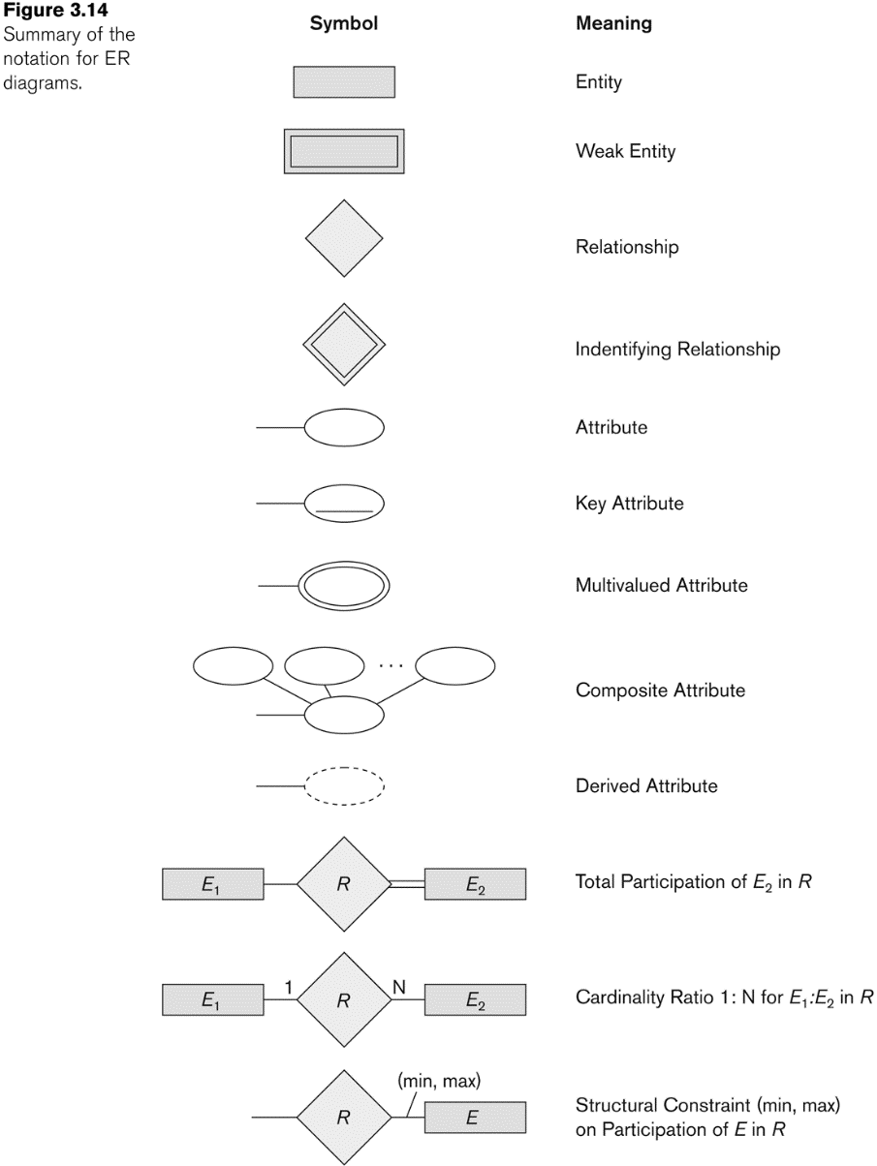
NOTATION for ER diagrams

Slide 10
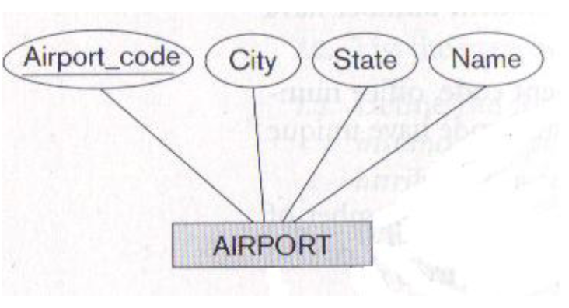
The diagram represents each AIRPORT,keeping its unique airport code, the airportname and the city and state in which it islocated.

Slide 11
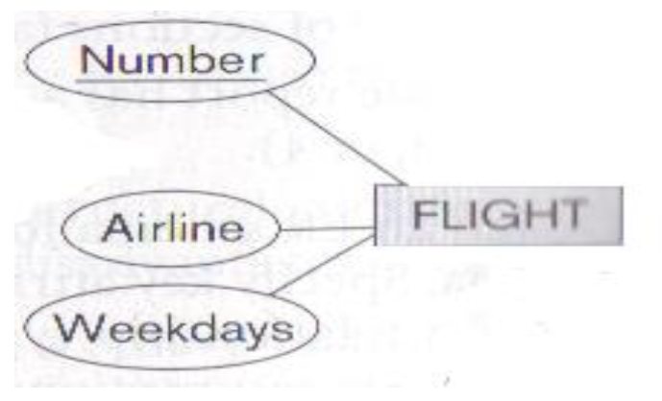
Each airline FLIGHT has a unique number,the airline to which it belongs and theweekdays on which it is scheduled.

Slide 12
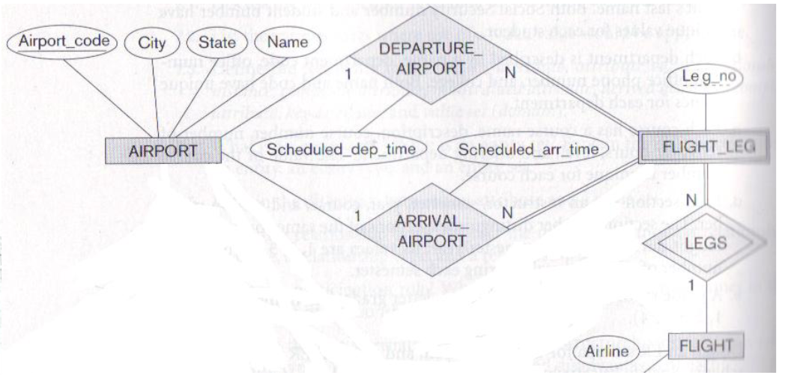
A flight is composed of one or more FLIGHT LEGS. Each FLIGHT LEG has a departure airport and scheduled departure time and an arrival airport and scheduled arrival time.

Slide 13
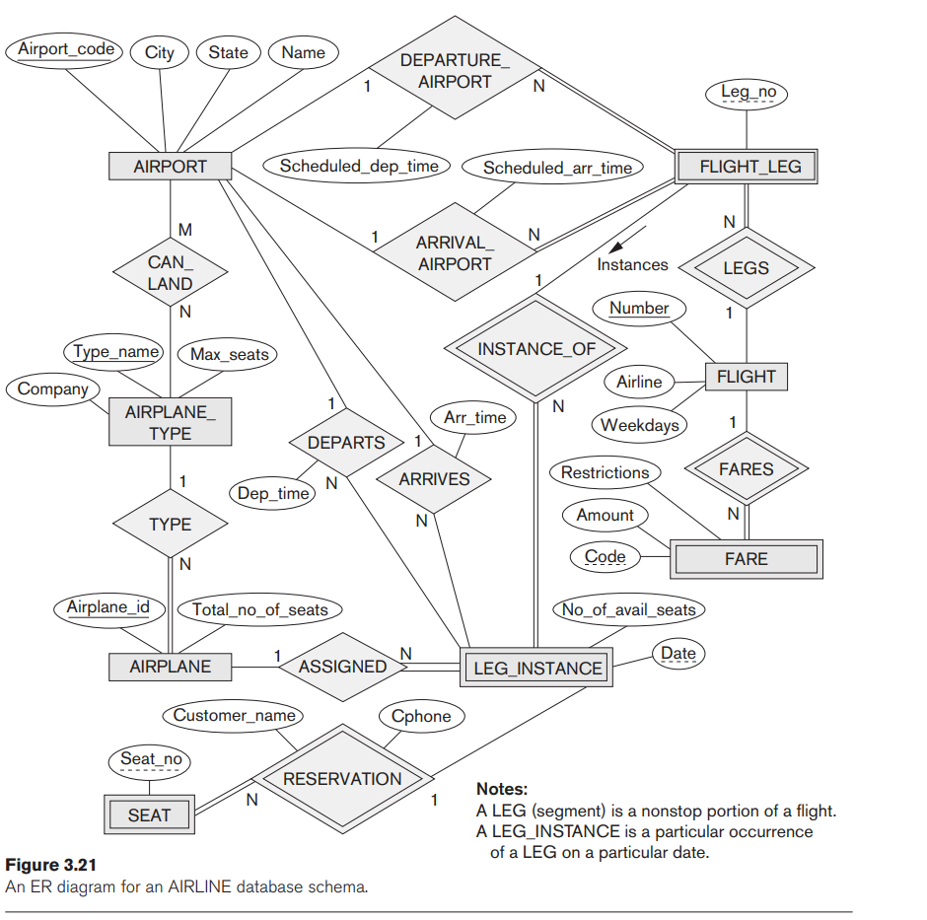

Slide 14
Methodologies for Conceptual Design
Entity Relationship (ER) Diagrams (This Chapter)
Enhanced Entity Relationship (EER) Diagrams (Chapter 4)
Use of Design Tools in industry for designing and documenting large scale designs
The UML (Unified Modeling Language) Class Diagrams are popular in industry to document conceptual database designs

Slide 15
Example COMPANY Database
We need to create a database schema design based on the following (simplified) requirements of the COMPANY Database:
The company is organized into DEPARTMENTs. Each department has a name, number and an employee who manages the department. We keep track of the start date of the department manager. A department may have several locations.
Each department controls a number of PROJECTs. Each project has a unique name, unique number and is located at a single location.

Slide 16
Example COMPANY Database (Continued)
The database will store each EMPLOYEE’s social security number, address, salary, gender, and birthdate.
Each employee works for one department but may work on several projects.
The DB will keep track of the number of hours per week that an employee currently works on each project.
It is required to keep track of the direct supervisor of each employee.
Each employee may have a number of DEPENDENTs.
For each dependent, the DB keeps a record of name, gender, birthdate, and relationship to the employee.

Slide 17
ER Model Concepts
Entities and Attributes
Entity is a basic concept for the ER model. Entities are specific things or objects in the mini-world that are represented in the database.
For example the EMPLOYEE John Smith, the Research DEPARTMENT, the ProductX PROJECT
Attributes are properties used to describe an entity.
For example an EMPLOYEE entity may have the attributes Name, SSN, Address, gender, BirthDate
A specific entity will have a value for each of its attributes.
For example a specific employee entity may have Name='John Smith', SSN='123456789', Address ='731, Fondren, Houston, TX', gender='M', BirthDate='09-JAN-55‘
Each attribute has a value set (or data type) associated with it – e.g. integer, string, date, enumerated type, …

Slide 18
Types of Attributes (1)
Simple
Each entity has a single atomic value for the attribute. For example, SSN or gender.
Composite
The attribute may be composed of several components. For example:
Address(Apt#, House#, Street, City, State, ZipCode, Country), or
Name(FirstName, MiddleName, LastName).
Composition may form a hierarchy where some components are themselves composite.
Multi-valued
An entity may have multiple values for that attribute. For example, Color of a CAR or PreviousDegrees of a STUDENT.
Denoted as {Color} or {PreviousDegrees}.

Slide 19
Types of Attributes (2)
In general, composite attributes may be nested arbitrarily to any number of levels, although this is rare.
For example, PreviousDegrees of a STUDENT is a composite multi-valued attribute denoted by {PreviousDegrees (College, Year, Degree, Field)}
Multiple PreviousDegrees values can exist
Each has four subcomponent attributes:
College, Year, Degree, Field

Slide 20
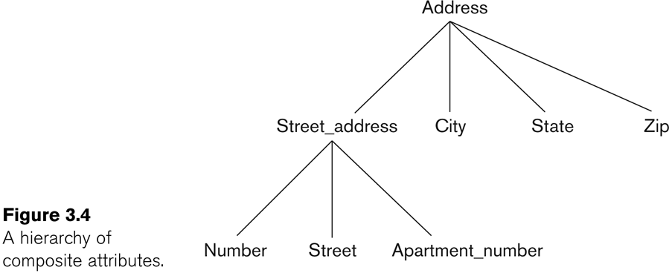
Example of a composite attribute

Slide 21
Entity Types and Key Attributes (1)
Entities with the same basic attributes are grouped or typed into an entity type.
For example, the entity type EMPLOYEE and PROJECT.
An attribute of an entity type for which each entity must have a unique value is called a key attribute of the entity type.
For example, SSN of EMPLOYEE.

Slide 22
Entity Types and Key Attributes (2)
A key attribute may be composite.
VehicleTagNumber is a key of the CAR entity type with components (Number, State).
An entity type may have more than one key.
The CAR entity type may have two keys:
VehicleIdentificationNumber (popularly called or aka VIN)
VehicleTagNumber (Number, State), aka license plate number.
Each key is underlined (Note: this is different from the relational schema where only one “primary key is underlined).

Slide 23
Entity Set
Each entity type will have a collection of entities stored in the database
Called the entity set or sometimes entity collection
Same name (CAR) used to refer to both the entity type and the entity set
However, entity type and entity set may be given different names
Entity set is the current state of the entities of that type that are stored in the database

Slide 24
Value Sets (Domains) of Attributes
Each simple attribute is associated with a value set
E.g., Lastname has a value which is a character string of upto 15 characters, say
Date has a value consisting of MM-DD-YYYY where each letter is an integer
A value set specifies the set of values associated with an attribute

Slide 25
Attributes and Value Sets
Value sets are similar to data types in most programming languages – e.g., integer, character (n), real, bit
Mathematically, an attribute A for an entity type E whose value set is V is defined as a function
A : E -> P(V)
Where P(V) indicates a power set (which means all possible subsets) of V. The above definition covers simple and multivalued attributes.
We refer to the value of attribute A for entity e as A(e).

Slide 26
Displaying an Entity type
In ER diagrams, an entity type is displayed in a rectangular box
Attributes are displayed in ovals
Each attribute is connected to its entity type
Components of a composite attribute are connected to the oval representing the composite attribute
Each key attribute is underlined
Multivalued attributes displayed in double ovals

Slide 27
NOTATION for ER diagrams

Slide 28
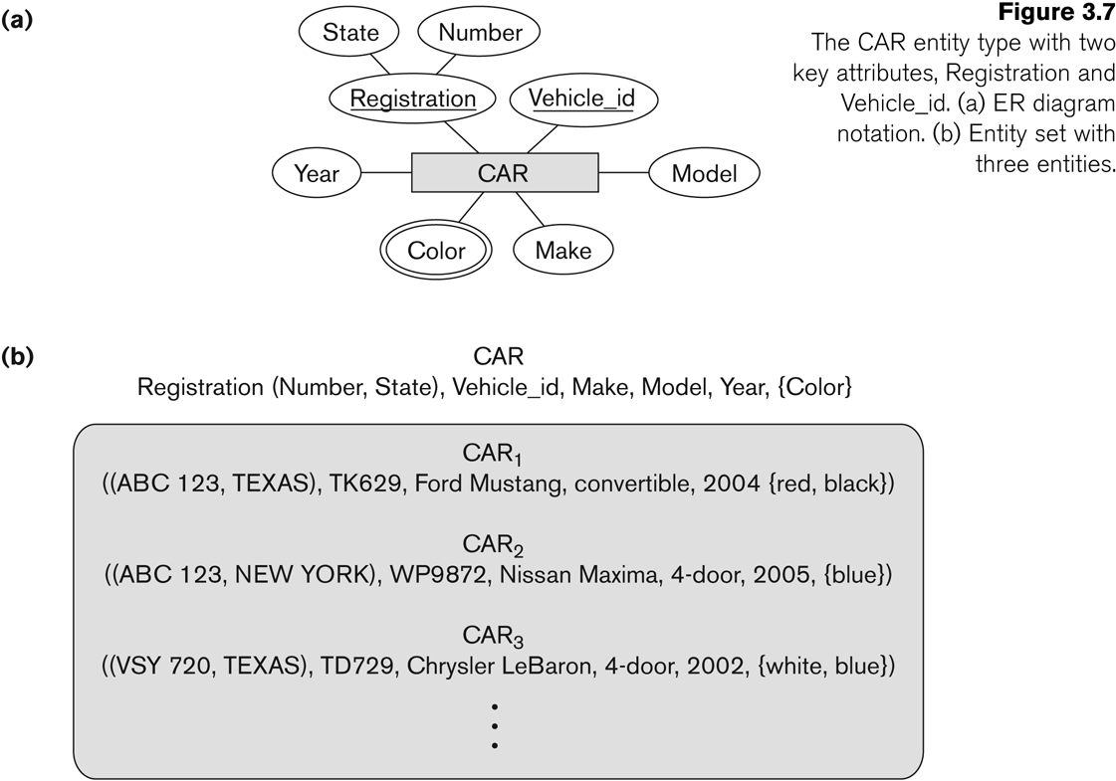
Entity Type CAR with two keys and a corresponding Entity Set

Slide 29
Initial Conceptual Design of Entity Types for the COMPANY Database Schema
Based on the requirements, we can identify four initial entity types in the COMPANY database:
DEPARTMENT
PROJECT
EMPLOYEE
DEPENDENT
The initial attributes shown are derived from the requirements description

Slide 30
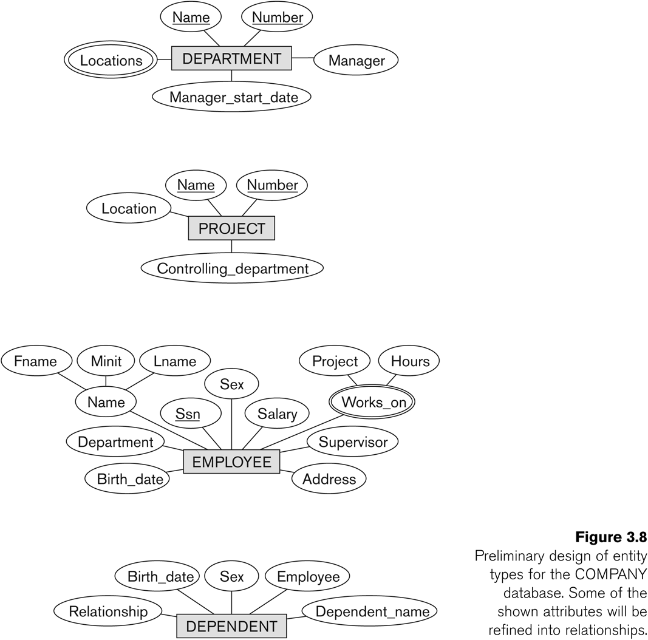
Initial Design of Entity Types: EMPLOYEE, DEPARTMENT, PROJECT, DEPENDENT

Slide 31
Activity - Categorize following attributes into their correct DBMS ATTRIBUTE type
Email Address | Salary | Medical Conditions
Full Name | Total Years of Experience | Preferred Contact Method
Phone Number | Favorite Books | Pet Names
Account Number | Emergency Contact | Annual Income
Street Address | Student ID | Joining Date
Date of Birth | Course Enrolled | Current Age
Social Security Number | Membership Level | User Preferences
Hobbies | Rewards Points | Country of Residence
Occupation | Vehicle Registration Number | Subscription Type
Security Questions | LinkedIn Profile | Last Login Date

Slide 32
Solution
Composite vs Simple Attributes
Composite Attributes:
Full Name
Street Address
Emergency Contact
Simple Attributes:
Email Address
Occupation
Membership Level
Country of Residence
LinkedIn Profile

Slide 33
Single-valued vs Multivalued Attributes
Single-valued Attributes:
Account Number
Date of Birth
Salary
Course Enrolled
Student ID
Annual Income
Joining Date
Multivalued Attributes:
Hobbies
Favorite Books
Medical Conditions
Pet Names
User Preferences
Security Questions

Slide 34
Solution
Derived vs Stored Attributes
Derived Attributes:
Total Years of Experience
Current Age
Stored Attributes:
Phone Number
Social Security Number
Rewards Points
Vehicle Registration Number
Subscription Type
Last Login Date

Slide 35
Solution
Strong vs Weak Entities
Strong Entities
Email Address: Independent entity representing a user's email.
Account Number: Unique identifier for an account.
Student ID: Unique identifier for a student.
Vehicle Registration Number: Unique identifier for a vehicle.
Occupation: Describes a person's job.
Weak Entities
Hobbies: Depends on a user or student.
Medical Conditions: Typically linked to a patient or individual profile.
Emergency Contact: Linked to a user or student profile.
Rewards Points: Associated with a specific account, hence weak.
User Preferences: Associated with a user profile.

Slide 36
Refining the initial design by introducing relationships
The initial design is typically not complete
Some aspects in the requirements will be represented as relationships
ER model has three main concepts:
Entities (and their entity types and entity sets)
Attributes (simple, composite, multivalued)
Relationships (and their relationship types and relationship sets)

Slide 37
Relationships and Relationship Types (1)
A relationship relates two or more distinct entities with a specific meaning.
For example, EMPLOYEE John Smith works on the ProductX PROJECT, or EMPLOYEE Franklin Wong manages the Research DEPARTMENT.
Relationships of the same type are grouped or typed into a relationship type.
For example, the WORKS_ON relationship type in which EMPLOYEEs and PROJECTs participate, or the MANAGES relationship type in which EMPLOYEEs and DEPARTMENTs participate.
The degree of a relationship type is the number of participating entity types.
Both MANAGES and WORKS_ON are binary relationships.

Slide 38
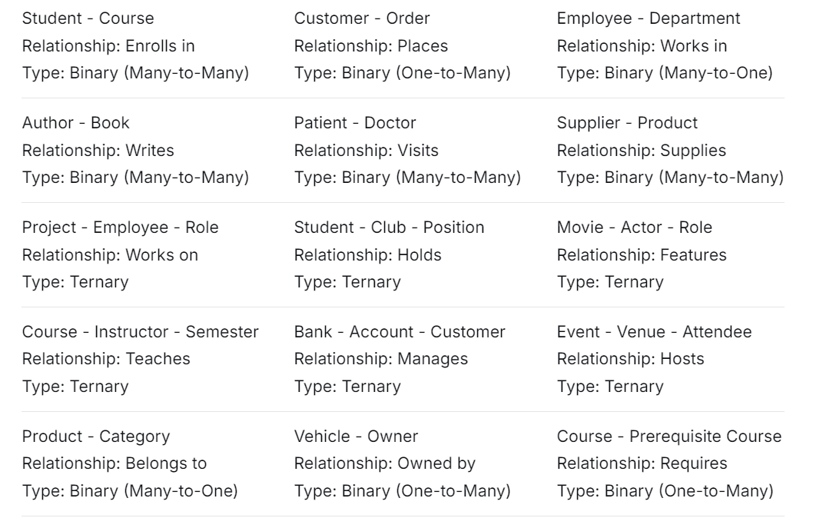
Relationships and Relationship Types (1)
A relationship relates two or more distinct entities with a specific meaning.

Slide 39
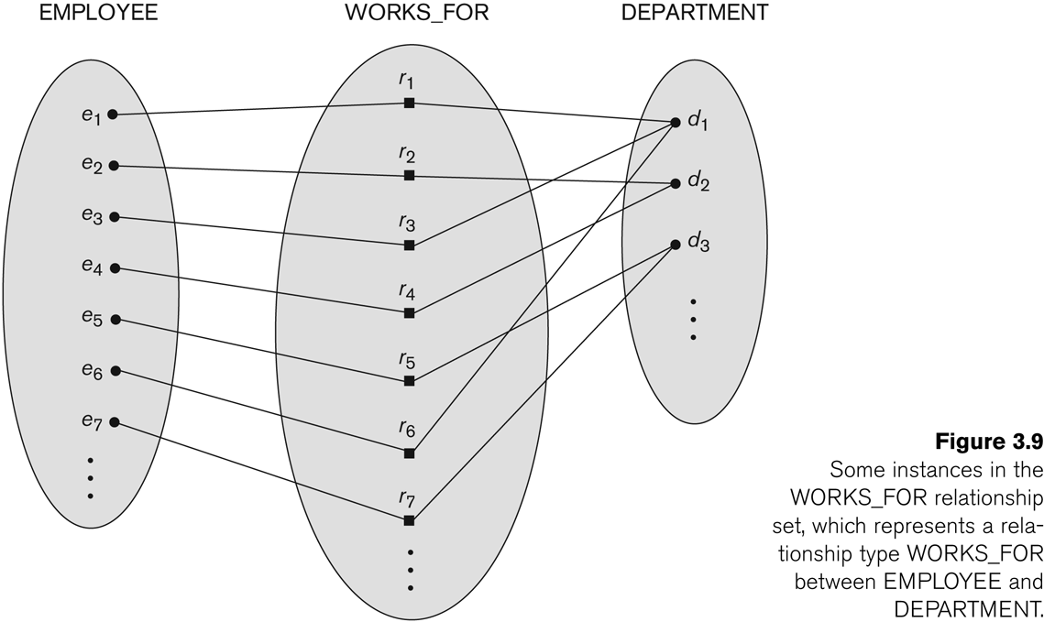
Relationship instances of the WORKS_FOR N:1 relationship between EMPLOYEE and DEPARTMENT

Slide 40
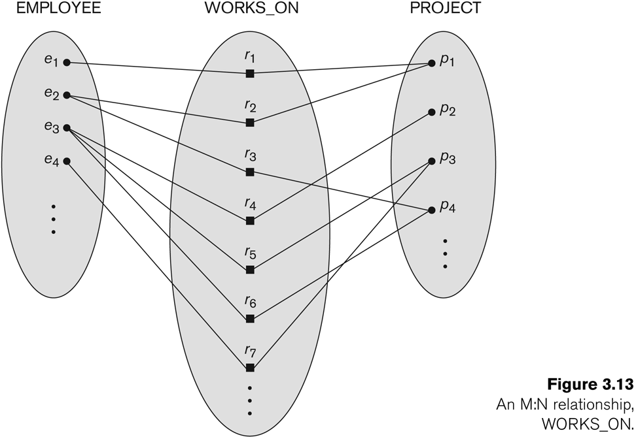
Relationship instances of the M:N WORKS_ON relationship between EMPLOYEE and PROJECT

Slide 41
Relationship type vs. relationship set (1)
Relationship Type:
Is the schema description of a relationship
Identifies the relationship name and the participating entity types
Also identifies certain relationship constraints
Relationship Set:
The current set of relationship instances represented in the database
The current state of a relationship type

Slide 42
Relationship type vs. relationship set (2)
Each instance in the set relates individual participating entities – one from each participating entity type
In ER diagrams, we represent the relationship type as follows:
Diamond-shaped box is used to display a relationship type
Connected to the participating entity types via straight lines
Note that the relationship type is not shown with an arrow. The name should be typically be readable from left to right and top to bottom.

Slide 43
Refining the COMPANY database schema by introducing relationships
By examining the requirements, six relationship types are identified
All are binary relationships( degree 2)
Listed below with their participating entity types:
WORKS_FOR (between EMPLOYEE, DEPARTMENT)
MANAGES (also between EMPLOYEE, DEPARTMENT)
CONTROLS (between DEPARTMENT, PROJECT)
WORKS_ON (between EMPLOYEE, PROJECT)
SUPERVISION (between EMPLOYEE (as subordinate), EMPLOYEE (as supervisor))
DEPENDENTS_OF (between EMPLOYEE, DEPENDENT)

Slide 44
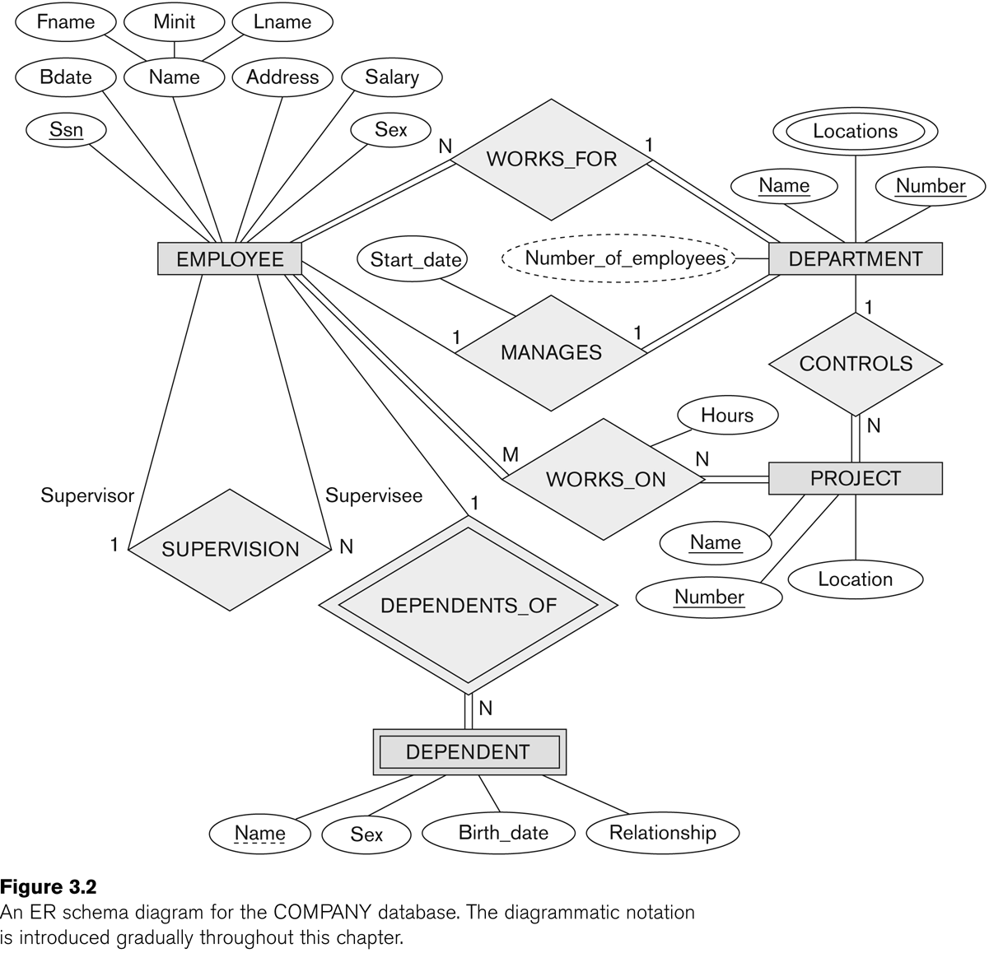
ER DIAGRAM – Relationship Types are: WORKS_FOR, MANAGES, WORKS_ON, CONTROLS, SUPERVISION, DEPENDENTS_OF

Slide 45
Discussion on Relationship Types
In the refined design, some attributes from the initial entity types are refined into relationships:
Manager of DEPARTMENT -> MANAGES
Works_on of EMPLOYEE -> WORKS_ON
Department of EMPLOYEE -> WORKS_FOR
etc
In general, more than one relationship type can exist between the same participating entity types
MANAGES and WORKS_FOR are distinct relationship types between EMPLOYEE and DEPARTMENT
Different meanings and different relationship instances.

Slide 46
Constraints on Relationships known as Structural Constraints
Constraints on Relationship Types
(Also known as ratio constraints)
Cardinality Ratio (specifies maximum participation)
One-to-one (1:1)
One-to-many (1:N) or Many-to-one (N:1)
Many-to-many (M:N)
Existence Dependency Constraint (specifies minimum participation) (also called participation constraint)
zero (optional participation, not existence-dependent, partial) – expressed as single line connecting the participating entity type to the relationship
one or more (mandatory participation, existence-dependent, total participation) – expressed as double line connecting the participating entity type to the relationship

Slide 47
Recursive Relationship Type
A relationship type between the same participating entity type in distinct roles
Also called a self-referencing relationship type.
Example: the SUPERVISION relationship
EMPLOYEE participates twice in two distinct roles:
supervisor (or boss) role
supervisee (or subordinate) role
Each relationship instance relates two distinct EMPLOYEE entities:
One employee in supervisor role
One employee in supervisee role

Slide 48
Recursive Relationship Type is: SUPERVISION (participation role names are shown)

Slide 49
Weak Entity Types
An entity that does not have a key attribute and that is identification-dependent on another entity type.
A weak entity must participate in an identifying relationship type with an owner or identifying entity type
Entities are identified by the combination of:
A partial key of the weak entity type
The particular entity they are related to in the identifying relationship type
Example:
A DEPENDENT entity is identified by the dependent’s first name, and the specific EMPLOYEE with whom the dependent is related
Name of DEPENDENT is the partial key
DEPENDENT is a weak entity type
EMPLOYEE is its identifying entity type via the identifying relationship type DEPENDENT_OF

Slide 50
Attributes of Relationship types
A relationship type can have attributes:
For example, HoursPerWeek of WORKS_ON
Its value for each relationship instance describes the number of hours per week that an EMPLOYEE works on a PROJECT.
A value of HoursPerWeek depends on a particular (employee, project) combination
Most relationship attributes are used with M:N relationships
In 1:N relationships, they can be transferred to the entity type on the N-side of the relationship

Slide 51
Example Attribute of a Relationship Type: Hours of WORKS_ON

Slide 52
Notation for Constraints on Relationships
Cardinality ratio (of a binary relationship): 1:1, 1:N, N:1, or M:N
Shown by placing appropriate numbers on the relationship edges.
Participation constraint (on each participating entity type): total (called existence dependency) or partial.
Total shown by double line, partial by single line.
NOTE: These are easy to specify for Binary Relationship Types.

Slide 53
Alternative (min, max) notation for relationship structural constraints:
Specified on each participation of an entity type E in a relationship type R
Specifies that each entity e in E participates in at least min and at most max relationship instances in R
Default(no constraint): min=0, max=n (signifying no limit)
Must have min≤max, min≥0, max ≥1
Derived from the knowledge of mini-world constraints
Examples:
A department has exactly one manager and an employee can manage at most one department.
Specify (0,1) for participation of EMPLOYEE in MANAGES
Specify (1,1) for participation of DEPARTMENT in MANAGES
An employee can work for exactly one department but a department can have any number of employees.
Specify (1,1) for participation of EMPLOYEE in WORKS_FOR
Specify (0,n) for participation of DEPARTMENT in WORKS_FOR

Slide 54
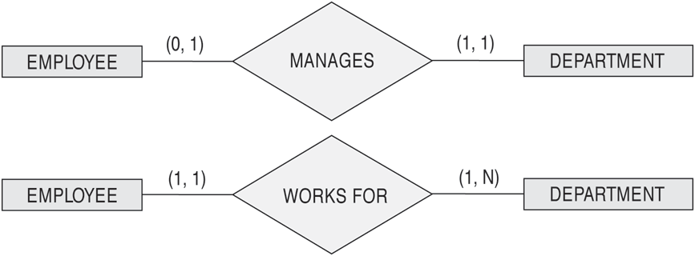
The (min,max) notation for relationship constraints
Read the min,max numbers next to the entity type and looking away from the entity type

Slide 55
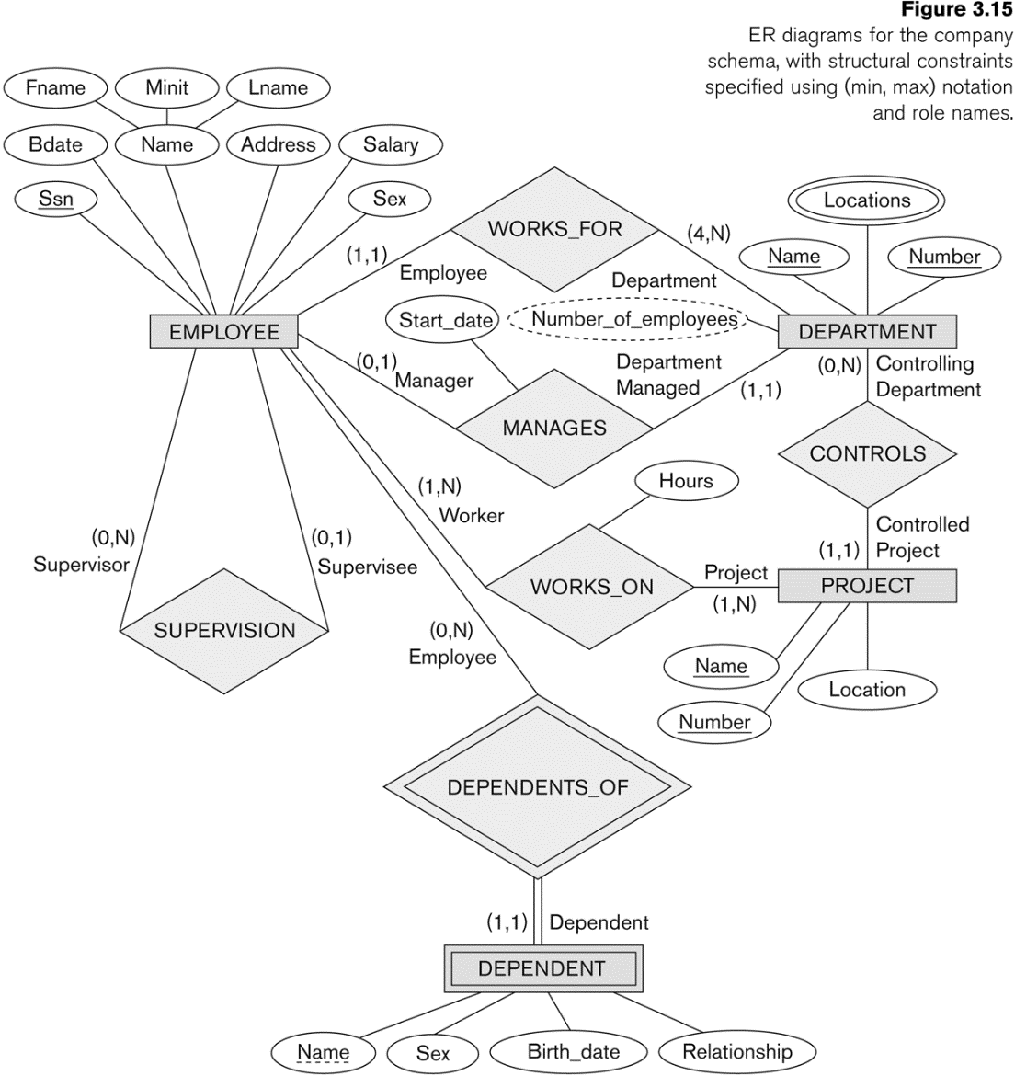
COMPANY ER Schema Diagram using (min, max) notation

Slide 56
Alternative diagrammatic notation
ER diagrams is one popular example for displaying database schemas
Many other notations exist in the literature and in various database design and modeling tools
Appendix A illustrates some of the alternative notations that have been used
UML class diagrams is representative of another way of displaying ER concepts that is used in several commercial design tools

Slide 57
Summary of notation for ER diagrams
Chen –
Our focus
is Chen
notations

Slide 58
UML class diagrams
Represent classes (similar to entity types) as large rounded boxes with three sections:
Top section includes entity type (class) name
Second section includes attributes
Third section includes class operations (operations are not in basic ER model)
Relationships (called associations) represented as lines connecting the classes
Other UML terminology also differs from ER terminology
Used in database design and object-oriented software design
UML has many other types of diagrams for software design

Slide 59
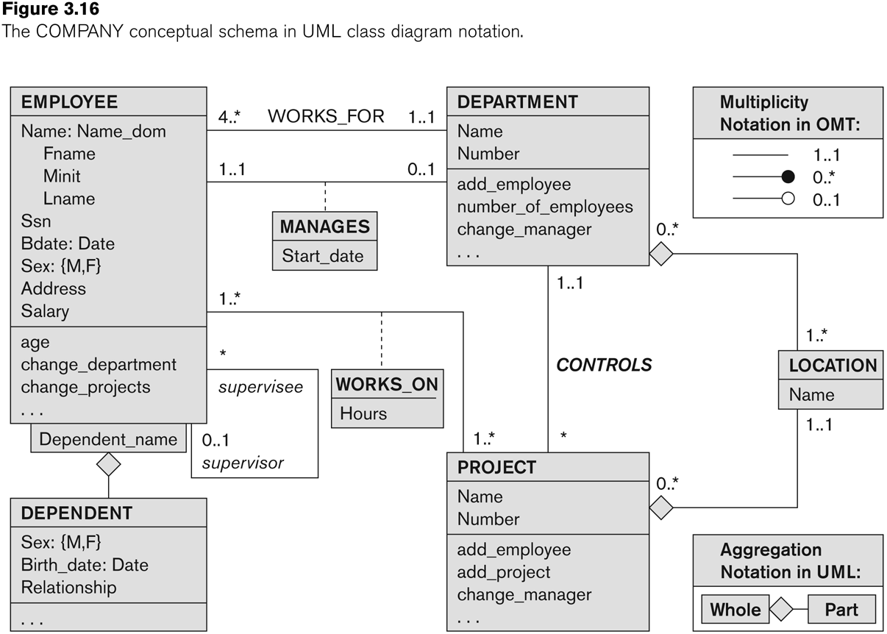
UML class diagram for COMPANY database schema

Slide 60
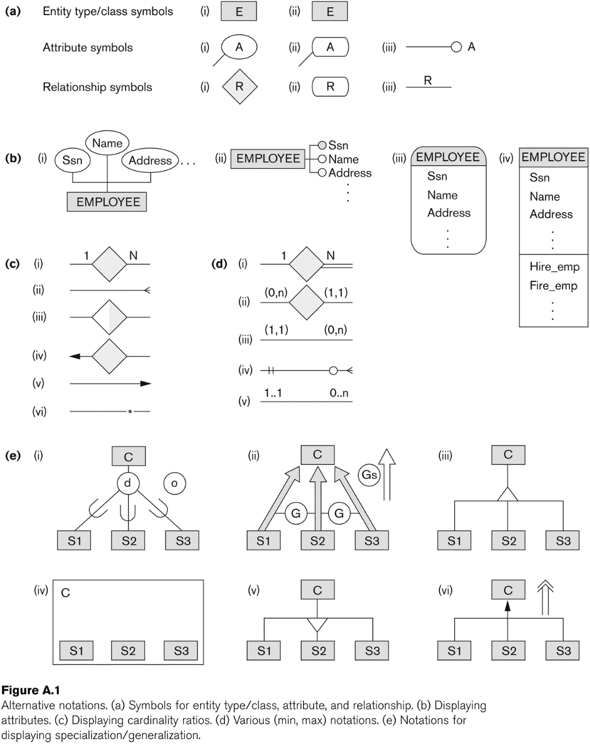
Other alternative diagrammatic notations
Chen – Our focus is Chen notations
Crow’s Foot
Bachman
IDEF1X
Barker
Notes:
A Guide to the Entity Relationship Diagram (ERD) - Database Star - https://www.databasestar.com/entity-relationship-diagram/

Slide 61
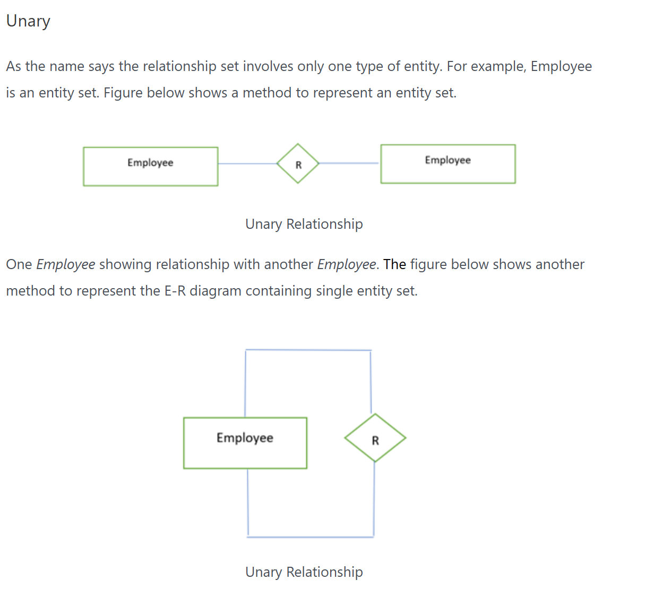

Slide 62
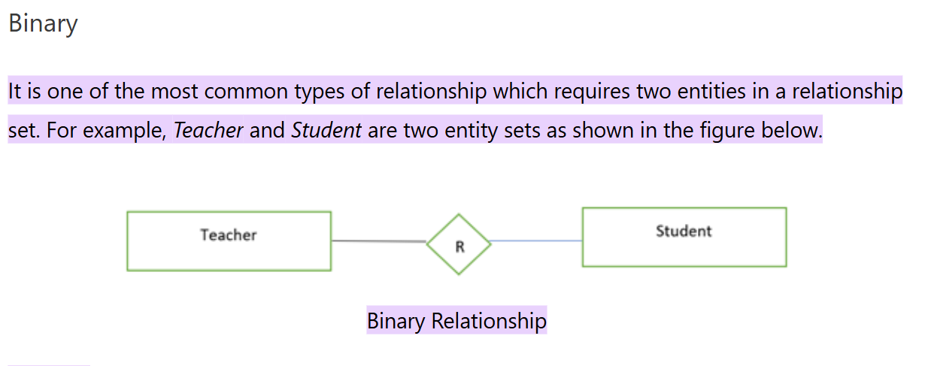

Slide 63
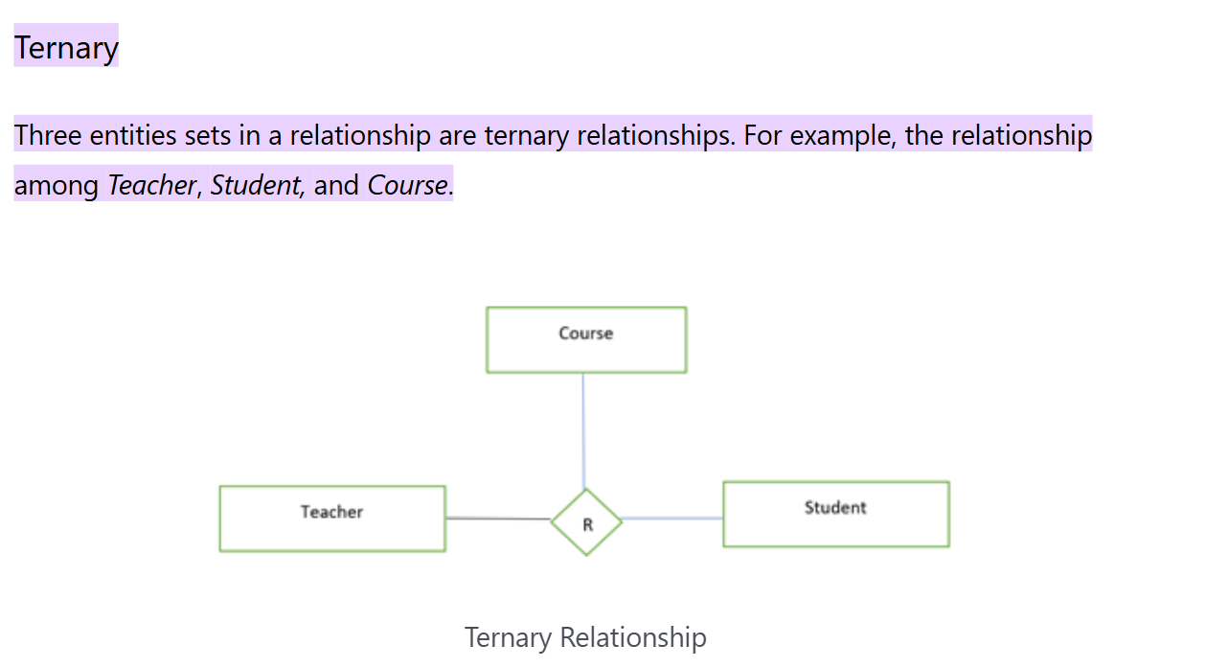

Slide 64
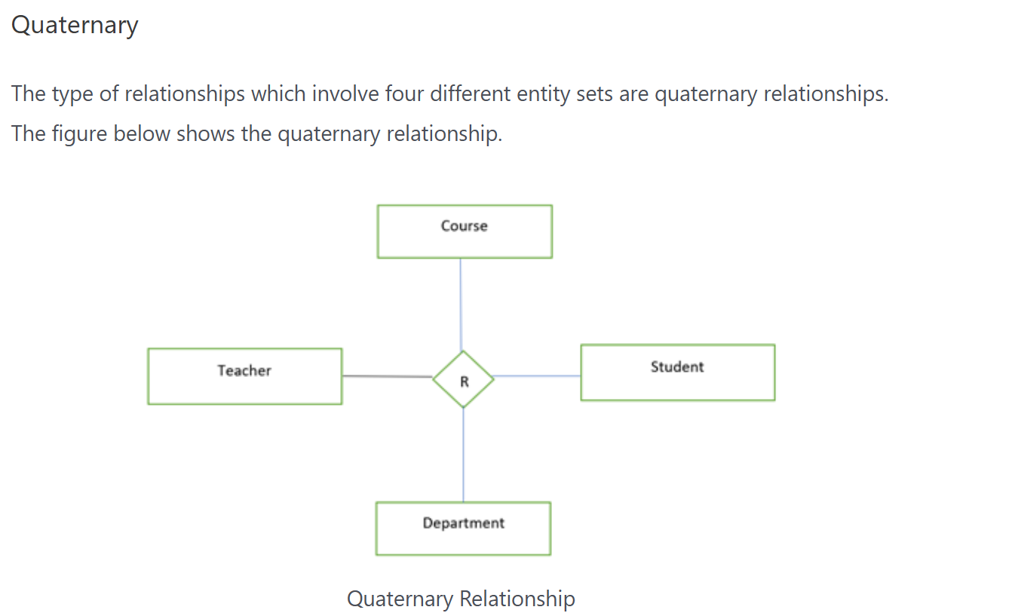

Slide 65
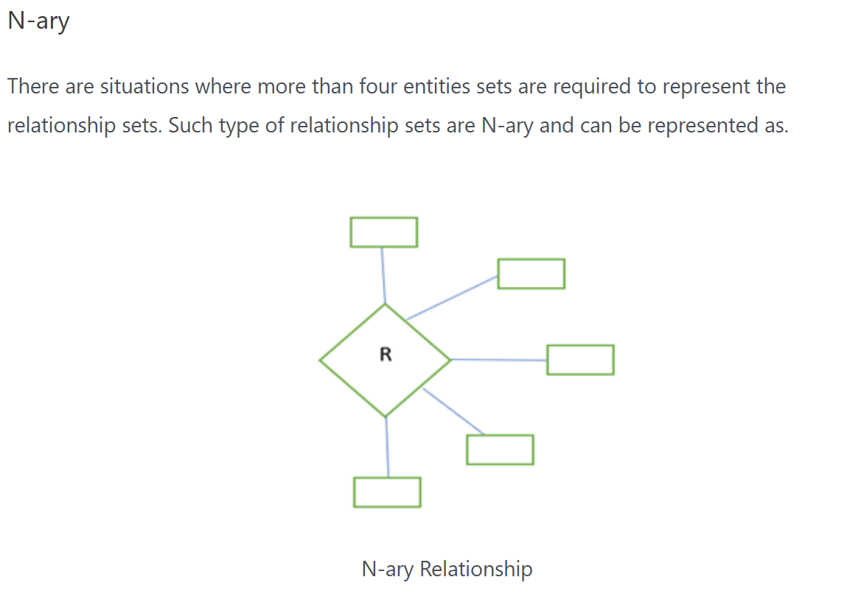

Slide 66
Relationships of Higher Degree
Relationship types of degree 2 are called binary
Relationship types of degree 3 are called ternary and of degree n are called n-ary
In general, an n-ary relationship is not equivalent to n binary relationships
Constraints are harder to specify for higher-degree relationships (n > 2) than for binary relationships

Slide 67
Discussion of n-ary relationships (n > 2)
In general, 3 binary relationships can represent different information than a single ternary relationship (see Figure 3.17a and b on next slide)
If needed, the binary and n-ary relationships can all be included in the schema design (see Figure 3.17a and b, where all relationships convey different meanings)
In some cases, a ternary relationship can be represented as a weak entity if the data model allows a weak entity type to have multiple identifying relationships (and hence multiple owner entity types) (see Figure 3.17c)

Slide 68
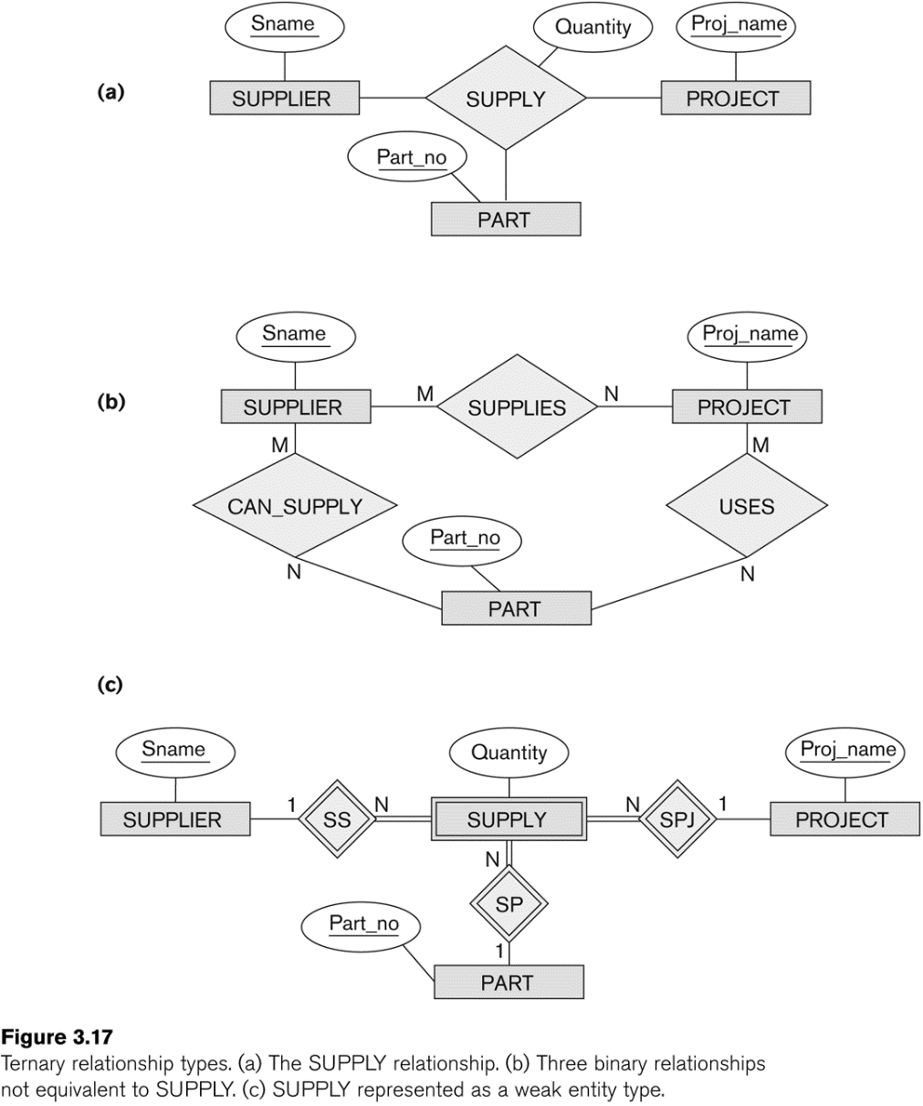
Example of a ternary relationship

Slide 69
Discussion of n-ary relationships (n > 2)
If a particular binary relationship can be derived from a higher-degree relationship at all times, then it is redundant
For example, the TAUGHT_DURING binary relationship in Figure 3.18 (see next slide) can be derived from the ternary relationship OFFERS (based on the meaning of the relationships)

Slide 70
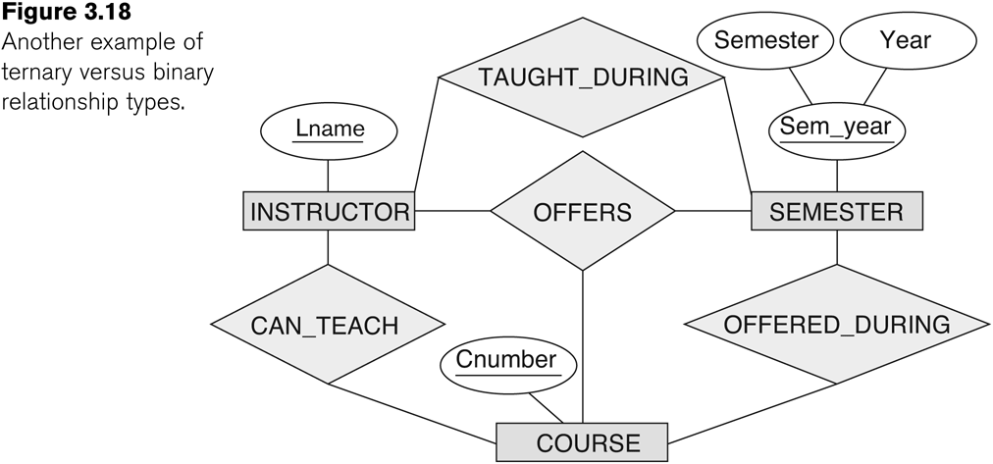
Another example of a ternary relationship

Slide 71
Displaying constraints on higher-degree relationships
The (min, max) constraints can be displayed on the edges – however, they do not fully describe the constraints
Displaying a 1, M, or N indicates additional constraints
An M or N indicates no constraint
A 1 indicates that an entity can participate in at most one relationship instance that has a particular combination of the other participating entities
In general, both (min, max) and 1, M, or N are needed to describe fully the constraints
Overall, the constraint specification is difficult and possibly ambiguous when we consider relationships of a degree higher than two.

Slide 72
Another Example: A UNIVERSITY Database
To keep track of the enrollments in classes and student grades, another database is to be designed.
It keeps track of the COLLEGEs, DEPARTMENTs within each college, the COURSEs offered by departments, and SECTIONs of courses, INSTRUCTORs who teach the sections etc.

Slide 73
Relationship Name | Entities Involved | Relationship Name | Entities Involved | Relationship Name | Entities Involved
Friends_with | STUDENT → STUDENT | Attends_organized_by | STUDENT → EVENT → ORGANIZATION | Attendance_Record | STUDENT → ATTENDANCE_RECORD(weak) → CLASS_SESSION
Mentor_of | STUDENT → STUDENT | Enrollment_record | STUDENT → COURSE → SEMESTER → PROFESSOR | Person_Hierarchy | PERSON ← STUDENT ← GRAD_STUDENT ← PHD_STUDENT
Reports_to | CLUB_MEMBER → CLUB_MEMBER | Room_assignment | STUDENT → ROOMMATE → DORMITORY → ACADEMIC_YEAR | Activity_Classification | ACTIVITY ← ACADEMIC / EXTRACURRICULAR

Slide 74
Relationship Name | Entities Involved | Relationship Name | Entities Involved | Relationship Name | Entities Involved
Enrolls_in | STUDENT → COURSE | Submits_for | STUDENT → COURSE → ASSIGNMENT | Study_Group | STUDENT → STUDY_GROUP → COURSE
Joins | STUDENT → CLUB | Borrows_for | STUDENT → LIBRARY → BOOK → CHECKOUT_PERIOD | Multiple_Relationships | STUDENT → STUDENT (multiple types)
Belongs_to | PROFESSOR → DEPARTMENT | Plays_for_as_during | STUDENT → SPORTS_TEAM → POSITION → SEASON | Course_Prerequisites | COURSE → PREREQUISITE
Works_on_for | STUDENT → PROJECT → COURSE | Grade_Report | STUDENT → GRADE_REPORT(weak) → COURSE | Event_Planning | STUDENT → COMMITTEE → BUDGET → VENDOR

Slide 75
Relationship Name | Entities Involved | Relationship Name | Entities Involved | Relationship Name | Entities Involved
Lives_in | STUDENT → DORMITORY | Serves_on_as_for | STUDENT → COMMITTEE → ROLE → EVENT | Internship_System | STUDENT → COMPANY → SUPERVISOR → FACULTY
Uses | COURSE → TEXTBOOK | Advised_by_for_in | STUDENT → ADVISOR → MAJOR → DEPARTMENT | Research_Participation | STUDENT → RESEARCH_PROJECT → PROFESSOR → GRANT
Takes_taught_by | STUDENT → COURSE → PROFESSOR | Awarded_from_by_for | STUDENT → SCHOLARSHIP → DONOR → ACADEMIC_YEAR | Tutoring_System | STUDENT(Tutor) → STUDENT(Tutee) → SUBJECT → SESSION
Works_on_for | STUDENT → PROJECT → COURSE | Grade_Report | STUDENT → GRADE_REPORT(weak) → COURSE | Event_Planning | STUDENT → COMMITTEE → BUDGET → VENDOR

Slide 76
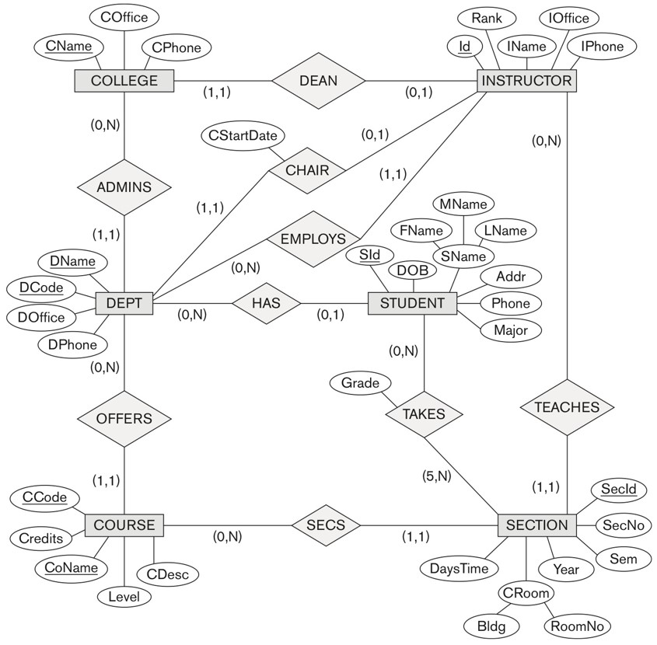

UNIVERSITY database conceptual schema

Slide 77
Recap - Conceptual, logical, physical
An Entity Relationship Diagram can be drawn at three different levels: conceptual, logical, or physical.
Each of these levels has a different level of detail and are used for a different purpose.
Let’s see some examples.

Slide 78
Conceptual data
The conceptual data model shows the business objects that exist in the system and how they relate to each other.
It defines the entities that exist, which are not necessarily tables. Thinking of tables is too detailed for this type of data model.

Slide 79
Logical Data Model
A logical model is a more detailed version of a conceptual data model. Attributes are added to each entity, and further entities can be added that represent areas to capture data in the system.

Slide 80
Physical Data Model
The physical data model is the most detailed data model in this process. It defines a set of tables and columns and how they relate to each other. It includes primary and foreign keys, as well as the data types for each column.
These diagrams can be created manually in a data modelling tool. They are also often generated by an IDE from an existing database.

Slide 81
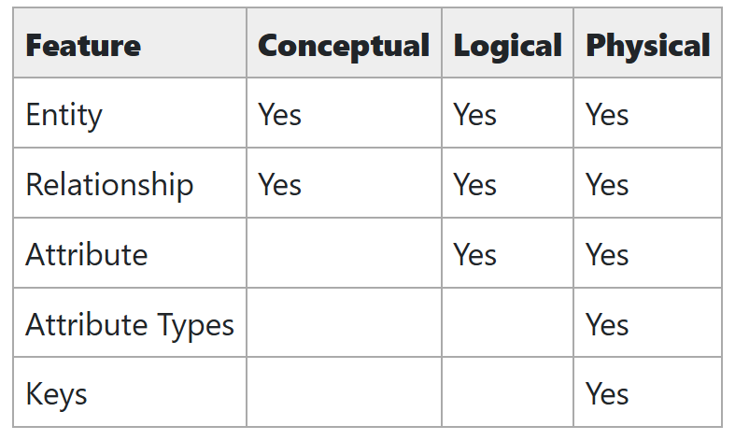
Summary

Slide 82
Some of the Automated Database Design Tools (Note: Not all may be on the market now)
COMPANY | TOOL | FUNCTIONALITY
Embarcadero Technologies | ER Studio | Database Modeling in ER and IDEF1X
 | DB Artisan | Database administration, space and security management
Oracle | Developer 2000/Designer 2000 | Database modeling, application development
Popkin Software | System Architect 2001 | Data modeling, object modeling, process modeling, structured analysis/design
Platinum (Computer Associates) | Enterprise Modeling Suite: Erwin, BPWin, Paradigm Plus | Data, process, and business component modeling
Persistence Inc. | Pwertier | Mapping from O-O to relational model
Rational (IBM) | Rational Rose | UML Modeling & application generation in C++/JAVA
Resolution Ltd. | Xcase | Conceptual modeling up to code maintenance
Sybase | Enterprise Application Suite | Data modeling, business logic modeling
Visio | Visio Enterprise | Data modeling, design/reengineering Visual Basic/C++

